Slide 1
Greek Letter Alerts

Slide 2
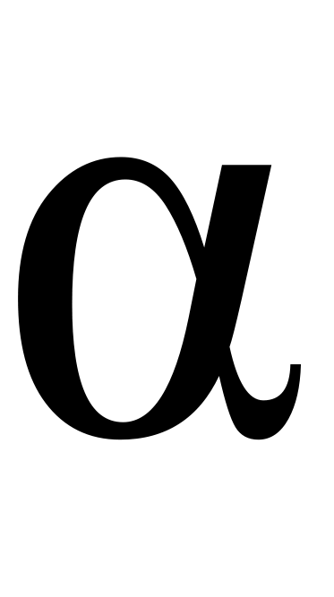
Greek Letter Alert
Lower-case alpha (“AL fuh”)
Greek lower-case a
First letter of Greek alphabet so used as a synonym for “first” or “beginning”
Physics:
  Angular acceleration (radians/sec²)
Chem/Phys:
  Alpha particle
  Alpha radiation
  Thermal expansion coefficient

Slide 3
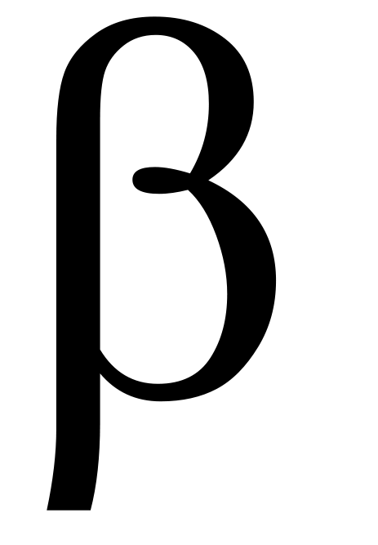
Greek Letter Alert
Lower-case beta (“BAY tuh”)
Greek lower-case b
Not to be confused with German “ss” or “sz”
Generic second variable in math and physics (where α would be the first variable)
β radiation and β particles, electrons or positrons from the nucleus

Slide 4
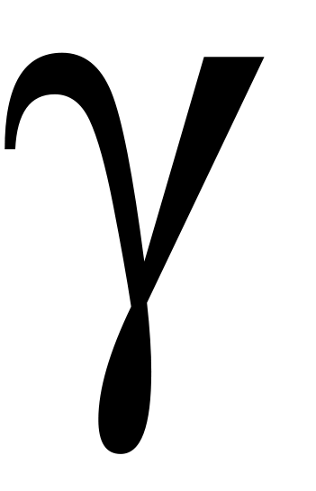
Greek Letter Alert
Lower-case gamma
(“GAM uh”)
Greek lower-case g
γ radiation, high-energy electromagnetic radiation
Specific weight, weight per unit volume γ = ρg

Slide 5
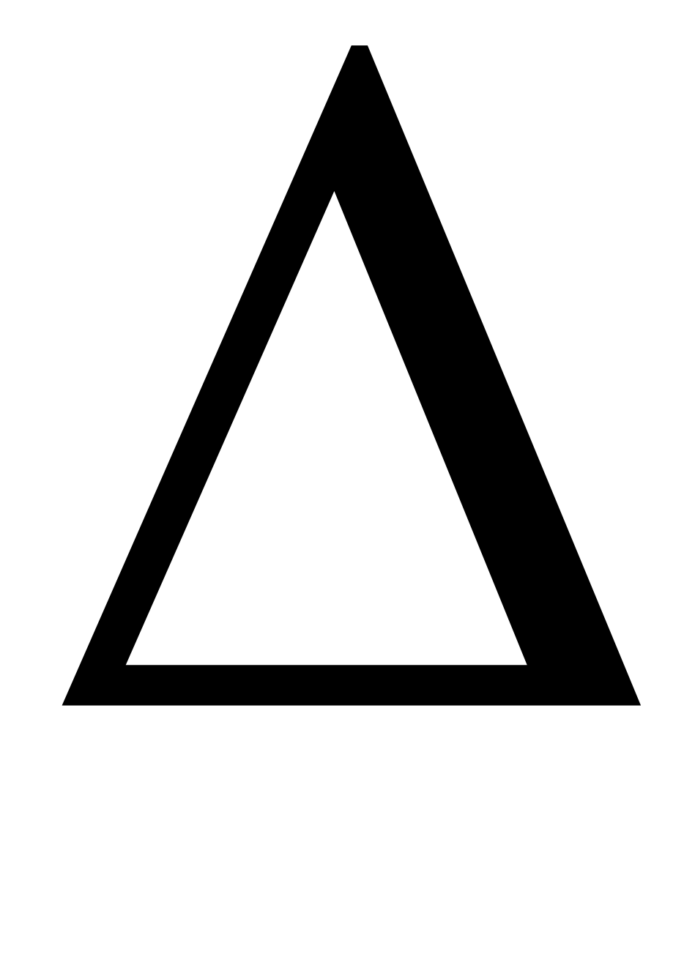
Greek Letter Alert
Capital delta (DELL-tuh)
Greek “D”
“Change in…”
Example
Δx is change in x
Always
final – initial
Change in
Position Δx = x_{f} – x_{i}
Velocity Δv = v_{f} – v_{i}
Temperature ΔT = T_{f} – T_{i}

Slide 6
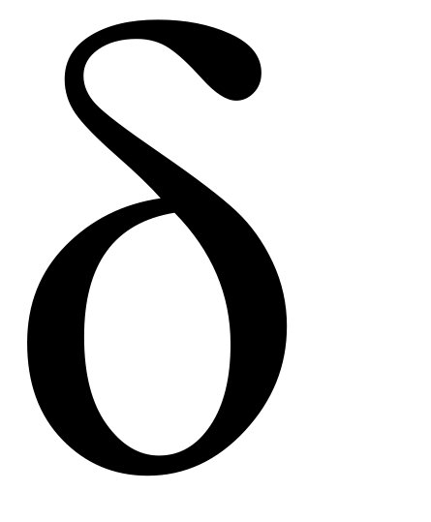
Greek Letter Alert
Lower-case delta
(DELL-tuh)
Greek lower-case d
Partial differential (calculus)
A small difference (compare Δ as large difference)
  δ+ Small + charge
  δ– Small (–) charge

Slide 7
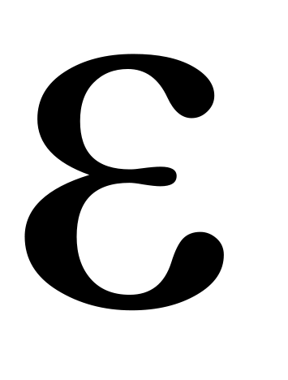
Greek Letter Alert
Lower-case epsilon
(“EP sil on”)
Greek lower-case e
Electromotive force
Dielectric permittivity
Emissivity of radiated energy
Strain in mechanics
Expected value in statistics (mean)

Slide 8
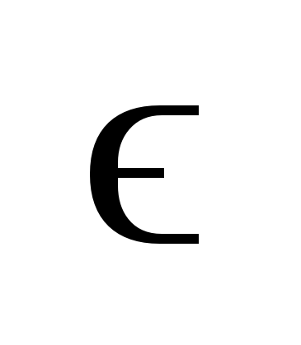
Greek Letter Alert
Lower-case epsilon
(“EP sil on”)
Greek lower-case e
“Lunate” glyph
Permittivity of free space (vacuum)

Slide 9
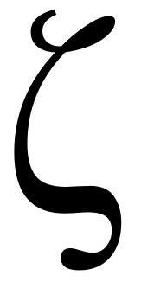
Greek Letter Alert
Lower-case zeta (ZEE-tuh or commonly ZAY-tuh)
Greek lower-case z
Damping ratio in
spring – damper systems
Heat flux across a plane
Effective nuclear charge of an electron (quantum chemistry)

Slide 10
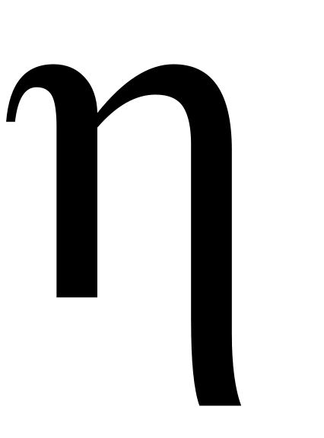
Greek Letter Alert
Lower-case eta (EE-tuh or commonly AY-tuh)
Greek lower-case h,
but long e sound
Efficiency
Electromagnet impedance in optics
Viscosity

Slide 11

Greek Letter Alert
Lower-case theta (THAY tuh)
Greek lower-case “th”
Variable for an angle on a plane
Angle θ
Angular displacement in radians
r
θ

Slide 12
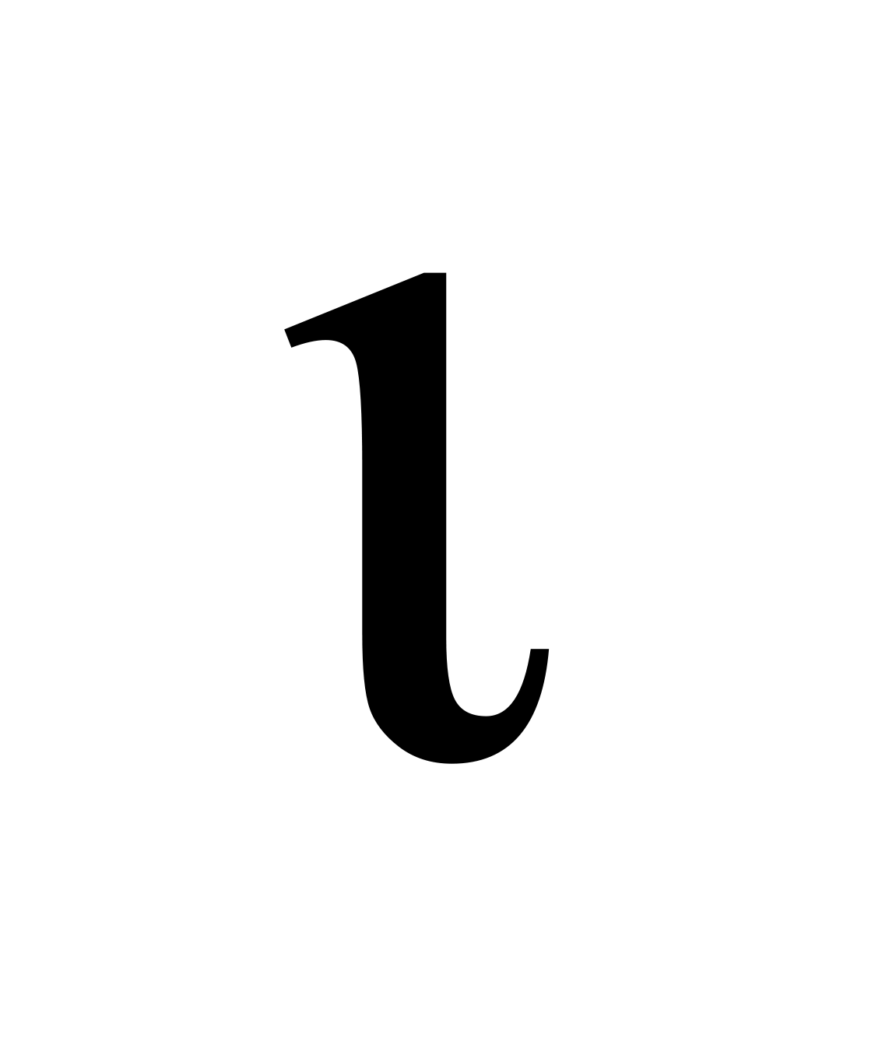
Greek Letter Alert
Lower-case iota
(ee-OH-tah or commonly eye-OH-tah)
Greek lower-case i

Slide 13
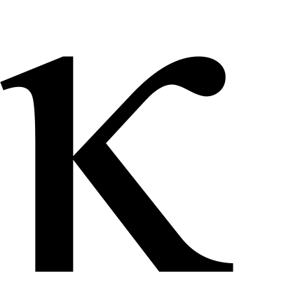
Greek Letter Alert
Lower-case kappa (cap-pah)
Lower-case Greek k
Curvature of curve
κ = 1/r where r = radius
Mean stress
Compressibility of a fluid in response to pressure

Slide 14

Greek Letter Alert
Lower-case lambda
(“LAMB-duh”)
Greek lower-case “L”
Wavelength (typically meters) v = λf
Decay constant
N(t) = N₀e^{-λt}

Slide 15
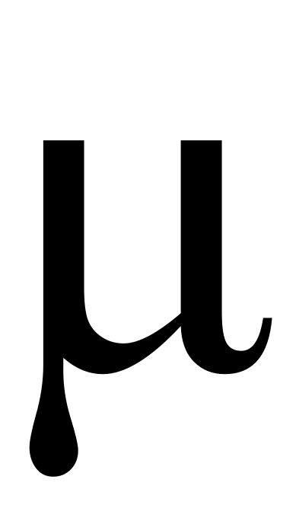
Greek Letter Alert
Lower-case mu (m-you)
Greek lower-case m
SI prefix for “micro”
μm for micrometer
Coefficient of static or kinetic friction (μ_{s}, μ_{k})

Slide 16
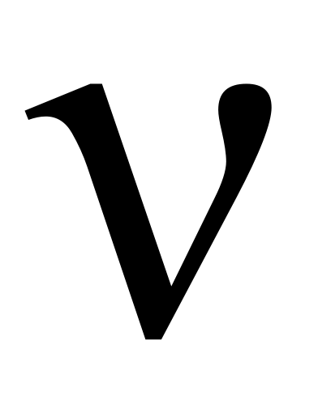
Greek Letter Alert
Lower-case nu
(“N – you”)
Greek lower-case ‘n’
Wave’s “spatial frequency” in cycles per meter (1/m) ν = 1/λ
Three types of neutrinos, subatomic particles
Kinematic viscosity in a fluid

Slide 17
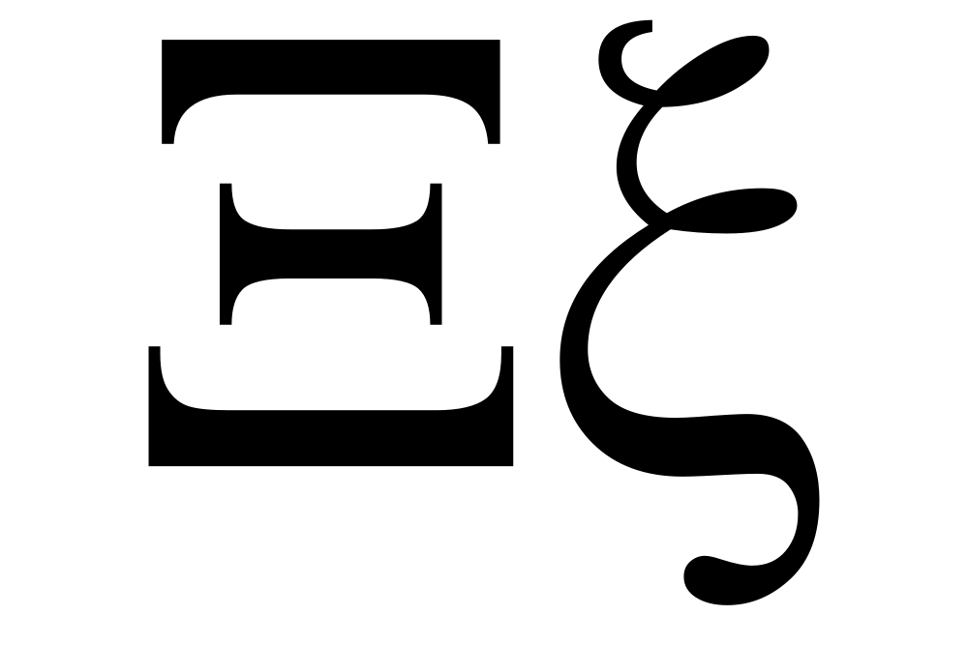
Greek Letter Alert
Upper-case xi (ksee in Greek, z-eye or s-eye in English)
No Latin alphabet equivalent
Xi barions: 1 up or down quark, 2 heavier quarks (strange, charmed or bottom)

Slide 18
Greek Letter Alert
Lower-case xi (ksee in Greek, z-eye or s-eye in English)
No Latin alphabet equivalent
Random variable in statistics
Average logarithmic energy decrement per collision for n⁰ in reactors

Slide 19
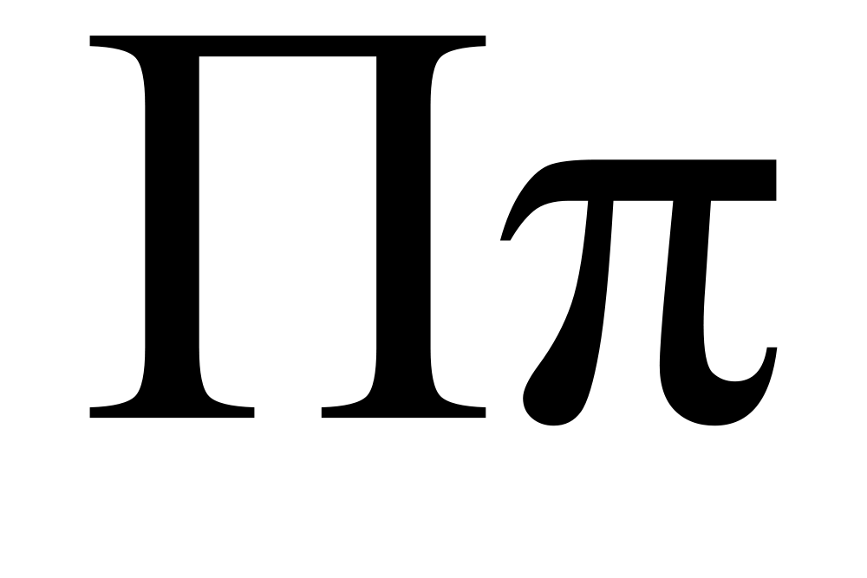
Greek Letter Alert
Upper-case pi (p-eye)
Greek upper-case P
Product operator
(like Σ is summation)
Π(2, 3, 4) = 2×3×4 = 24

Slide 20
Greek Letter Alert
Lower-case pi (p-eye)
Greek lower-case p
Ratio of circle’s circumference to diameter
3.14159265…
From the first letter of “perimeter”
The prime counting function
Notes:
Prime counting function: π(x) counts the number of prime numbers less than or equal to x.

Slide 21
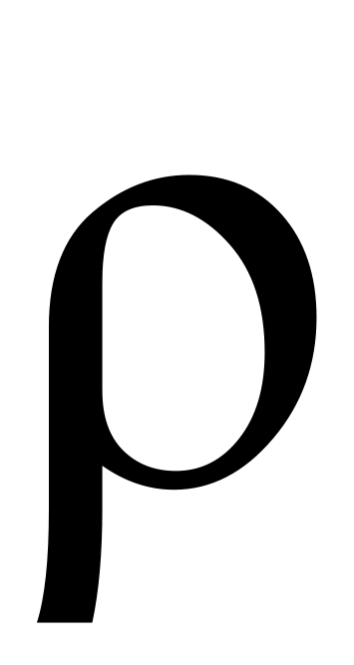
Greek Letter Alert
Lower-case rho (“row”)
Lower-case Greek “r”
Similar to but not to be confused with Latin “p”
Chemistry & Physics
  Density
  Resistivity
  Charge density
Mathematics
  Radius in polar coordinates
  Correlation coefficient

Slide 22
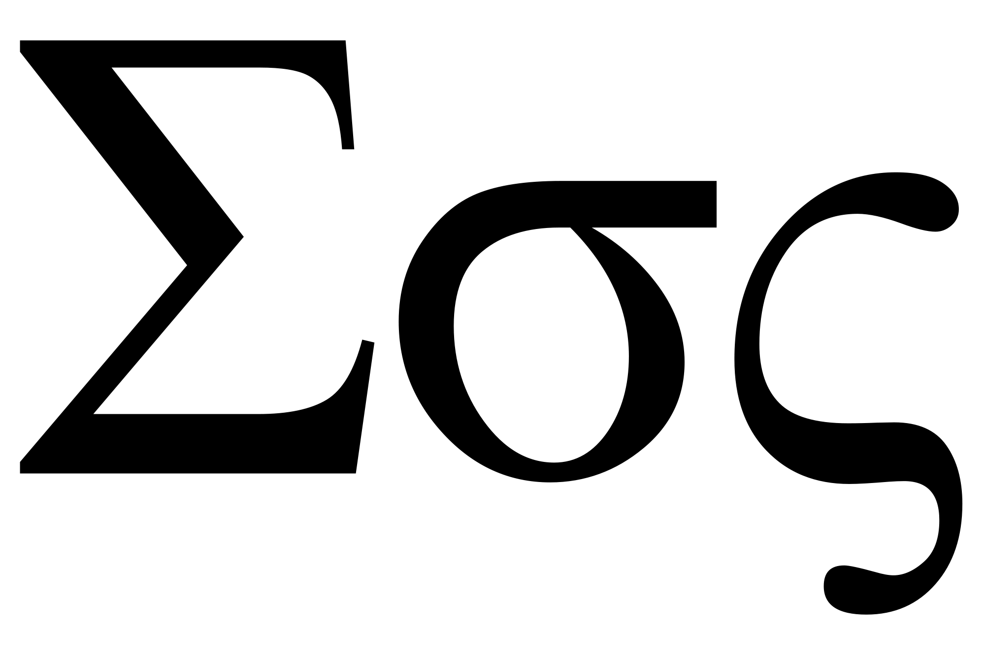
Greek Letter Alert
Capital sigma
(“SIG muh”)
Greek “S”
“Sum of…”
Example
ΣF is the sum of all forces acting on a body
Scalar or vector quantities

Slide 23
Greek Letter Alert
Lower-case sigma
(“SIG muh”)
Greek lower-case s
Statistics: Standard deviation or “spread” of a population
Chemistry: Sigma bonds
  Strongest covalent bonds
  “Head-on” overlapping between orbitals
Surface charge density

Slide 24
Greek Letter Alert
Lower-case sigma
(“SIG muh”)
Greek lower-case s
Another form of σ, similar to g and g or a and a

Slide 25
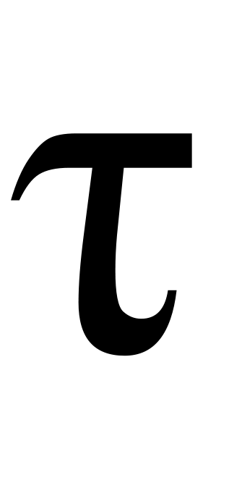
Greek Letter Alert
Lower-case tau
“Tow” like “cow,” not “toe”
Greek “t”
Torque τ = r × F
Time constant or lifetime for any logarithmically decaying process
  Radioactivity
  RC circuits
Shear stress in mechanics
Tau lepton subatomic particle
(uses capital tau, Τ)

Slide 26

Greek Letter Alert
Upper-case upsilon
(UP-sill-on or
YOUP-sill-on)
Greek lower-case Y
Normally looks like Latin capital Y in serif font
Subatomic upsilon meson, b + b

Slide 27
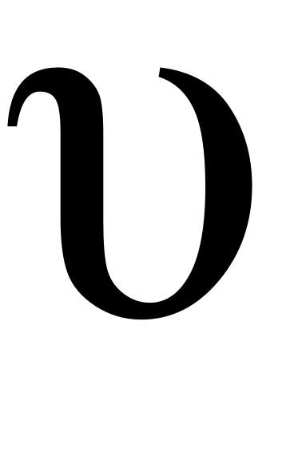
Greek Letter Alert
Lower-case upsilon
(UP-sill-on or YOUP-sill-on)
Greek lower-case y

Slide 28
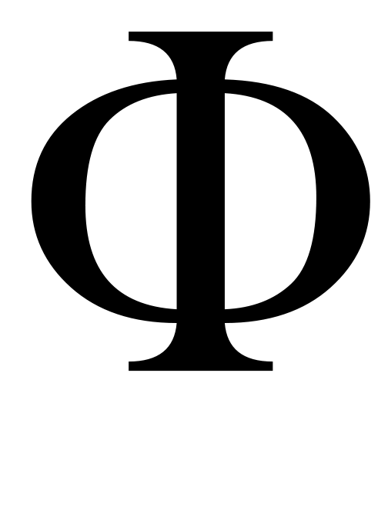
Greek Letter Alert
Upper-case phi
(fee or fye)
Greek “ph” or “f”
Magnetic and electric flux, differentiated with subscripts, Φ_{M} and Φ_{E}, respectively
Cumulative distribution function of the normal distribution

Slide 29

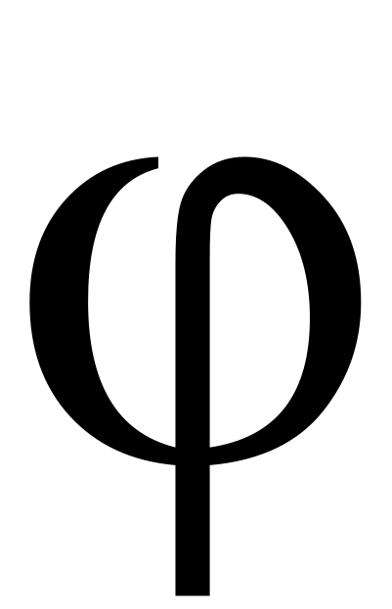
Greek Letter Alert
Lower-case phi
(fee or fye)
Greek lowercase
“ph” or “f”
Two forms, like g and g
Variable for a second angle on a plane:
Second angle ϕ
The phase of a wave
Electric potential

Slide 30
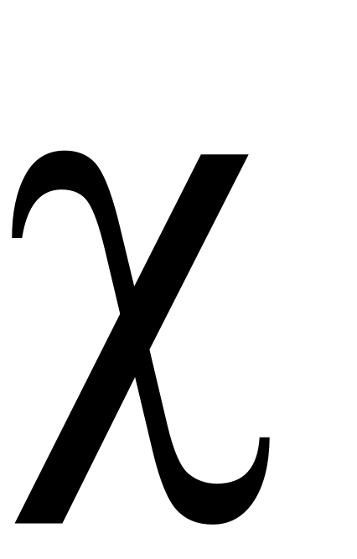
Greek Letter Alert
Lower-case chi
(k-eye)
Pronounced like kh- similar to German ich or the h in English human
Used in statistics to compare observed to theoretical values

Slide 31
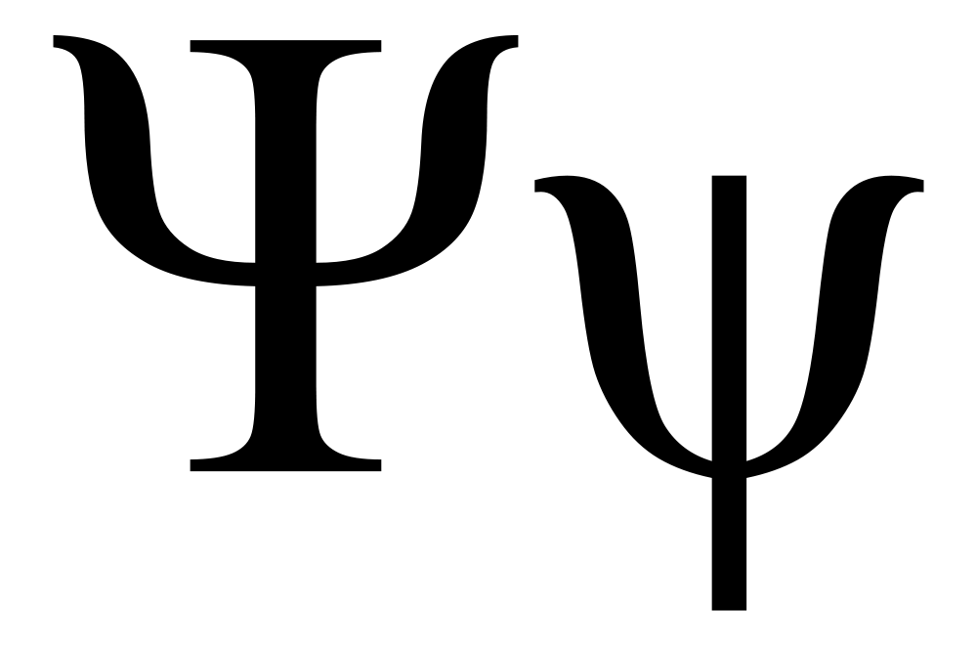
Greek Letter Alert
Psi (sigh)
Combination of ps as in lapse
At the beginning of a word, pronunciation usually simplified to just s
Wave function in Schrödinger equation describing quantum states

Slide 32
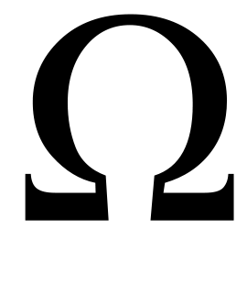
Greek Letter Alert
Upper-case omega
(oh MAY guh)
Literally “great o”
Last letter of Greek alphabet:
“alpha to omega”
Abbreviation for units of electrical resistance

Slide 33
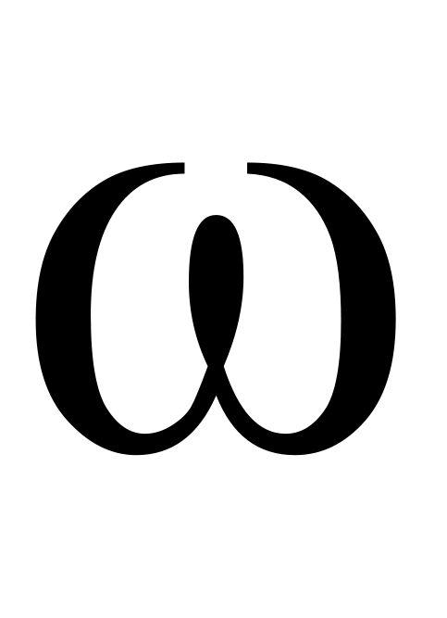
Greek Letter Alert
Lower-case omega
(oh MAY guh)
Literally “great o”
Last letter of Greek alphabet:
“alpha to omega”
Angular velocity in radians / second

